Slide 1
Introduction to Air Quality Monitoring
Importance of Monitoring
Key Pollutants
Monitoring air quality is crucial for assessing the health risks associated with air pollution. Real-time data enables informed decisions to protect public health and the environment. This project offers a practical approach to environmental monitoring.
CO₂ (Carbon Dioxide): A greenhouse gas that contributes to climate change.
NH₃ (Ammonia): Contributes to the formation of particulate matter.
Toluene: A volatile organic compound (VOC) that can cause respiratory issues.

Slide 2
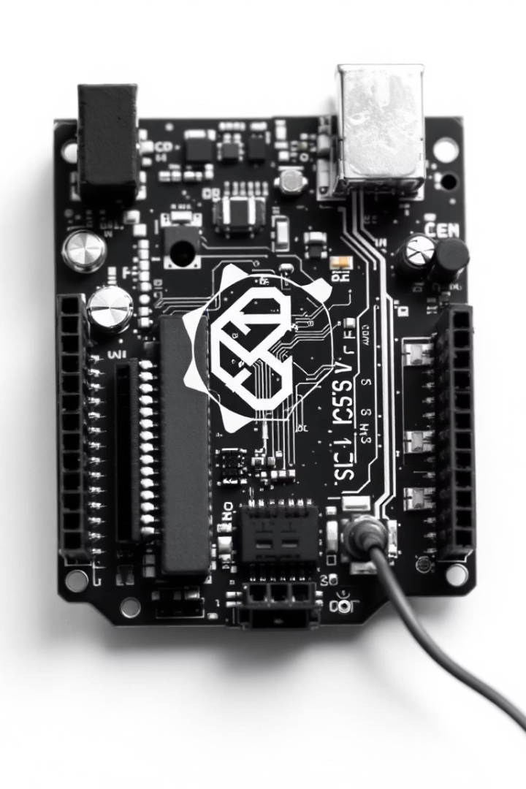
Project Objectives
1
Real-time AQI Monitor
2
Data Visualization
Develop a Python script to graphically display the AQI data, CO2, NH3 and Toluene levels gathered by the MQ135 sensor, providing visual insights into air quality fluctuations.
Construct a system that provides real-time monitoring of air quality using an Arduino Uno microcontroller and a MQ135 gas sensor.
3
LCD Display
Implement a 16x2 LCD to show the real-time Air Quality Index (AQI) for immediate on-site readings and easy access to the information being collected.

Slide 3
Literature Survey
1. Arduino-Based Environmental Monitoring Systems
Purpose of Study: The studies by Kurniawan et al. (2018) and Patel et al. (2019) highlight the growing use of Arduino microcontrollers in developing cost-effective and efficient environmental monitoring systems. These systems are designed to track parameters such as air quality, temperature, and humidity in real time. Method Used: Arduino microcontrollers serve as the core of these systems, interfacing with various sensors, including gas, temperature, and humidity sensors. The collected data is processed in real time and displayed on user interfaces, such as LCDs, or transmitted wirelessly via Bluetooth or Wi-Fi for remote monitoring. Key Findings and Results: The studies demonstrate that Arduino-based systems are highly reliable and scalable, offering flexibility in customizing sensor configurations for specific applications. Their affordability and ease of programming make them accessible to a wide range of users, including researchers, hobbyists, and small-scale industries. Conclusion: Arduino platforms have revolutionized environmental monitoring by providing accessible, scalable, and customizable solutions. They enable widespread adoption of air quality monitoring technologies in both developed and developing regions.

Slide 4
2. Gas Sensors for Air Quality Monitoring
Purpose of Study: Cheng et al. (2016) and Dey (2018) focus on the role of gas sensors in air quality monitoring, specifically examining the performance of the MQ-135 sensor. This sensor is widely used for detecting harmful gases such as carbon dioxide (CO2), ammonia (NH3), nitrogen oxides (NOx), and benzene. Method Used: The MQ-135 sensor uses metal-oxide semiconductor (MOS) technology to measure gas concentrations by detecting changes in electrical resistance. It is calibrated to provide accurate readings under varying environmental conditions. Key Findings and Results: The studies highlight the MQ-135 sensor’s high sensitivity and versatility, making it suitable for multi- gas detection in indoor and outdoor environments. However, the sensor's accuracy can be affected by factors such as temperature and humidity, necessitating periodic calibration for optimal performance. Conclusion: The MQ-135 is a reliable and cost-effective sensor for air quality monitoring, capable of detecting a wide range of pollutants with high sensitivity.

Slide 5
3. Air Quality Index (AQI) Calculation Standards
Purpose of Study: Research by Kumar et al. (2017) and Gupta et al. (2020) focuses on standardized methodologies for calculating the Air Quality Index (AQI). The AQI provides a simplified, easy-to-understand representation of air pollution levels, helping individuals assess environmental health risks. Method Used: The studies detail how AQI values are calculated based on pollutant concentrations and breakpointvalues defined by agencies such as the U.S. Environmental Protection Agency (EPA) and the World Health Organization (WHO). These breakpoints categorize AQI into ranges (e.g., Good, Moderate, Unhealthy) to convey health implications clearly. Key Findings and Results: The AQI framework effectively translates complex air quality data into actionable information, promoting public awareness and enabling informed decision-making regarding outdoor activities and health precautions. Conclusion: The AQI has proven to be an essential tool for public communication, enabling effective dissemination of air quality information to a broad audience.

Slide 6
4. LCD Display for Real-Time Data Visualization
Purpose of Study: Singh et al. (2015) and Yadav et al. (2020) investigate the integration of LCDs into embedded systems to enhance real-time data visualization. LCDs are commonly used for displaying environmental monitoring data, providing users with immediate feedback. Method Used: LCD modules, such as the 16x2 and 20x4 variants, are interfaced with microcontrollers to display real- time data in a clear, user-friendly format. They can show numerical values and custom messages, improving the overall user experience. Key Findings and Results: The studies show that LCDs are highly effective in displaying data in real time, offering clear visibility even in varying light conditions. Their low power consumption and ease of integration make them a preferred choice for portable monitoring systems. Conclusion: LCD displays enhance the functionality of monitoring devices by providing immediate, easy-to-read feedback, ensuring users can interpret data quickly and accurately.

Slide 7
5. Impact of Air Pollution on Health
Purpose of Study: Studies by Brook et al. (2010) and Lelieveld et al. (2015) highlight the severe health impacts of airpollution, particularly in urban areas. The focus is on how prolonged exposure to pollutants can lead to chronic respiratory and cardiovascular diseases. Method Used: The research involves longitudinal studies correlating air quality data with health outcomes, using large datasets to assess the long-term effects of exposure to pollutants like CO2, NOx, and particulate matter (PM2.5, PM10). Key Findings and Results: The studies confirm a strong link between poor air quality and an increased risk of respiratory illnesses, cardiovascular problems, and even premature death. Vulnerable populations, including children and the elderly, are particularly at risk. Conclusion: Understanding the health impacts of air pollution underscores the importance of real-time air quality monitoring, which can help mitigate exposure and improve public health outcomes.

Slide 8
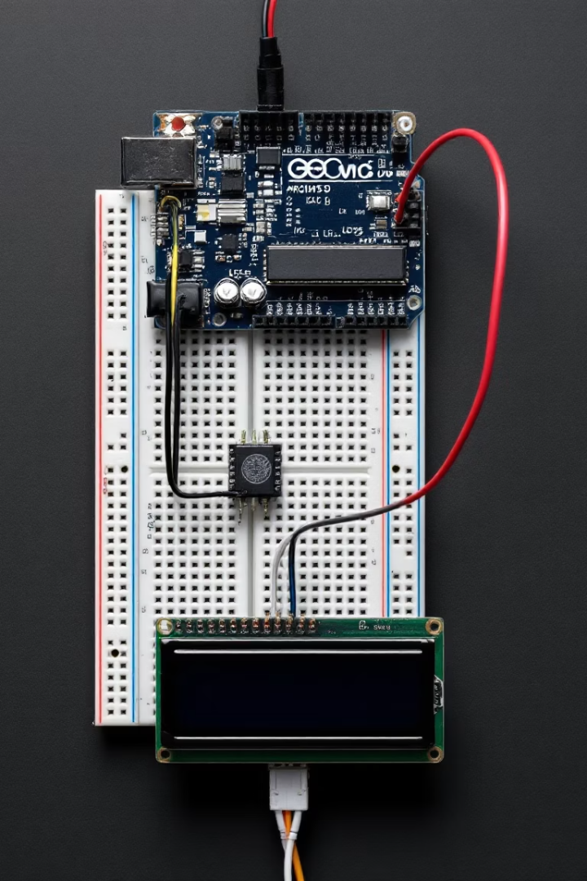




Components Used
MQ135 Gas Sensor
Arduino Uno
16x2 LCD Display
Jumper Wires
The MQ135 sensor detects a broad range of gases. The Arduino Uno processes sensor data and controls the LCD. The 16x2 LCD displays the AQI. Jumper wires connect all components on the breadboard.

Slide 9
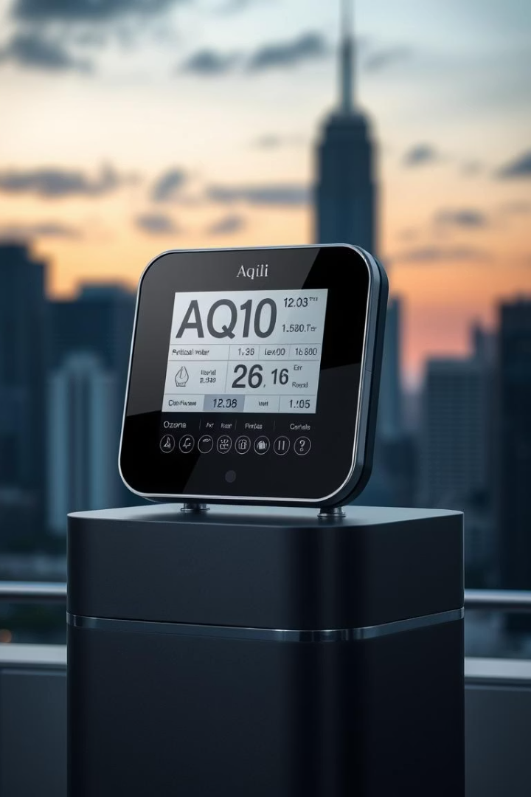
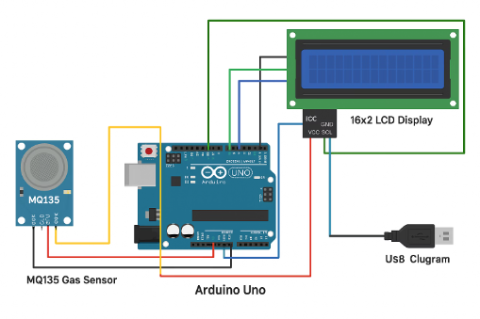
Circuit Diagram
The diagram shows how each component is wired together on the breadboard, ensuring proper functionality of the air quality monitoring system. The diagram is necessary for assembling this project.

Slide 10





Methodology
Gas Detection
MQ135 detects concentrations of gases like CO₂, NH₃, and Toluene.
Resistance Conversion
Sensor resistance values are converted to PPM (parts per million).
AQI Calculation
Relative AQI values are calculated based on PPM levels.
Data Display
LCD shows AQI in real-time; Python script graphs live data.

Slide 11

Arduino Code Overview
Sensor Reading
AQI Calculation
The Arduino code initializes the MQ135 sensor and continuously reads gas concentration values.
Raw sensor data is processed to calculate the Air Quality Index (AQI) based on predefined formulas and reference values.
Serial Output
The calculated AQI and individual pollutant levels are formatted and sent via serial communication to a connected computer.

Slide 12
Results and Discussion
The system successfully monitors and displays real-time AQI readings on the LCD. Results indicate the system's capability for continuous environmental monitoring.
The project evaluates the Air Quality Index (AQI) Monitoring Device's performance using three key metrics:
Sensor Accuracy: Determines the precision of the MQ-135 sensor in detecting air pollutants and calculating AQI values.
Response Time: Measures the system’s efficiency in providing real-time AQI feedback by
analysing the delay between sensor readings and display updates.
Display Performance: Assesses the clarity and reliability of the LCD screen in showing AQI values in various environmental conditions.

Slide 13
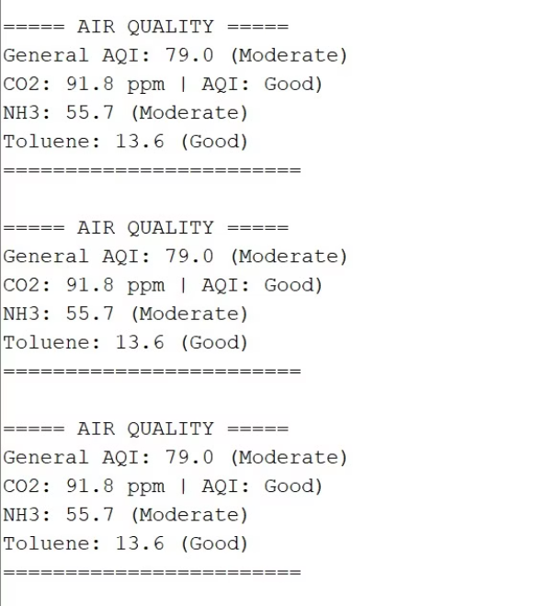
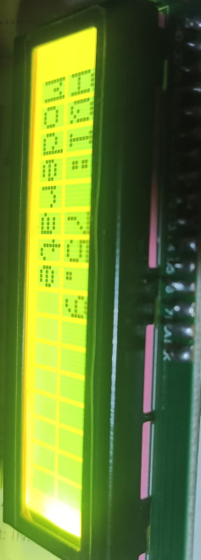
Indoor Reading

Slide 14
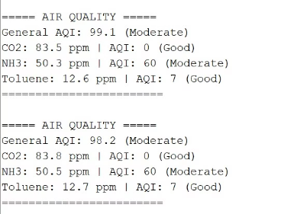
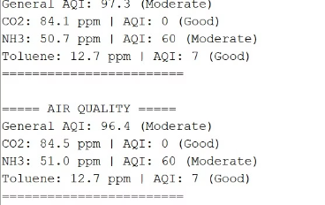
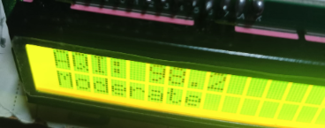
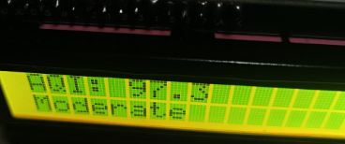
Outdoor Readings

Slide 15
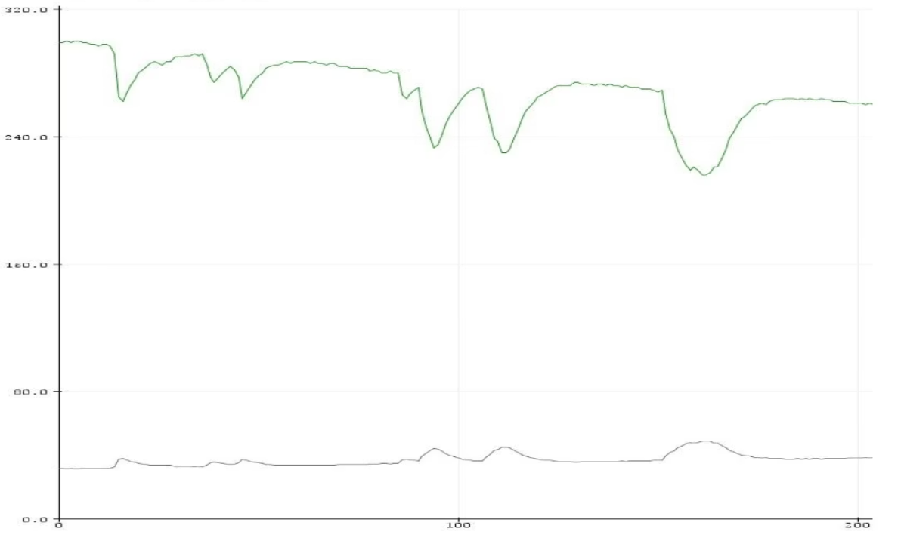
Graph

Slide 16

Conclusion and Future Improvements
Successful AQI Monitoring
Real-time AQI monitoring achieved using MQ135 sensor and Arduino.
Possible Enhancements
Implement Wi-Fi module, Blynk integration, or a cloud dashboard
The project successfully demonstrates a functional real-time AQI monitoring system. Future enhancements include adding a Wi-Fi module for remote data logging, Blynk integration for smartphone control, and a cloud dashboard for comprehensive data visualization and analysis.

Slide 17
References
• Arduino Documentation. (n.d.). Arduino Reference Guide. • Wire Library. (n.d.). I2C Communication for Arduino Microcontrollers. • LiquidCrystal_I2C Library. (n.d.). LiquidCrystal I2C Documentation for LCD Control. • MQ-135 Gas Sensor Datasheet. (n.d.). Technical Documentation for Air Quality Measurement. • Han, J., Kamber, M., & Pei, J. (2011). Data Mining: Concepts and Techniques (3rd ed.). Elsevier.

